Slide 1

School of Information Technology and Engineering
B tech IT WINTER SEMESTER 2017-18
Final Project
SMART TRAFFIC MANAGEMENT SYSTEM
Project by :
Ashish Arora (13BIT0024)
Nakul Sethi (13BIT0068)
Chirag Arora (13BIT0247)
Project Guide:
Prof. Usha Devi G.

Slide 2
ABSTRACT
Setup Raspberry Pi along with Web camera as an IoT Client to click the photos of the traffic junction where cameras can be installed and upload it on Dropbox Server in case any of the sensors (Water Logging) crosses a threshold value or periodically every minute. We can also view these photos remotely, using any mobile device equipped with a browser and having internet access. So the traffic authorities will have remote access to any traffic junction over the internet in real time and this can save the requirement of traffic police at every junction.
We will use LED’s simulating traffic lights and as soon as the RED Light is on, the IR sensors become active and any one crossing the IR sensor or jumping the red light is captured on the camera. This can help in reducing red light jumps as people will be conscious of the camera being used to monitor traffic and a record being maintained online.
Generate a SMS alert as soon as a sensor is triggered or Panic button on the hardware is pressed. This will be generated by Raspberry Pi using internet services and can be sent to Police/Traffic/MCD, as required. The SMS would be sent using internet enabled SMS services.
We’ll be using the default distribution of Linux (Raspbian) on Raspberry Pi as our O.S. and will write our code and scripts in Python.

Slide 3
Problem Statement
Imagine driving your way through the monstrous bumper to bumper Delhi traffic. Blasting horns, reckless Bluelines, motorcycles whizzing past, endless auto rickshaws, lazy Bullocks vying for space there’s no solution to the complete chaos and madness.
Smart Traffic Management System is essentially the application of computer and communications technologies coming in aid of the transport problems. Its technologies enable gathering of data or intelligence and then providing timely feedback to traffic managers and road-users. It results in improved safety to drivers, better traffic efficiency, reduced traffic congestion, improved energy efficiency and environmental quality and enhanced economic productivity.
There would be less number of accidents, respective authority for the road conditions, water logging will be notified immediately.
We are hereby thinking to accomplish stuff that has not been thought by anyone till now. Improving our road safety is one of the most important aspect every country should think about.
Smart Traffic Management System using Raspberry pi:-After rapid growth of raspberry pi this system has been implemented. Compared from existing systems, this system consumes less power & standalone but the drawbacks are when Raspberry pi device fails to deliver the commands in time major problems occurs also we have to remember those commands for every time.

Slide 4
Earlier, we looked into the face of future when we talked about automated devices, which could do anything on instigation of a controller, but today it has become a reality. An raspberry pi device can replace good amount of human working force, moreover humans are more prone to errors and in intensive conditions the probability of error increases whereas, an raspberry pi device can work with diligence, versatility and with almost zero error. Replacing human operators in tasks that involve hard physical or monotonous work. From the convenience of a simple cell phone, a user is able to control and monitor virtually any traffic red light.
Smart Traffic Management System is essentially the application of computer and communications technologies coming in aid of the transport problems. ITS technologies enable gathering of data or intelligence and then providing timely feedback to traffic managers and road-users. ITS results in improved safety to drivers, better traffic efficiency, reduced traffic congestion, improved energy efficiency and environmental quality and enhanced economic productivity.
There would be less number of accidents, respective authority for the road conditions, water logging will be notified immediately.
We are hereby thinking to accomplish stuff that has not been thought by anyone till now. Improving our road safety is one of the most important aspect every country should think about.

Slide 5
INTRODUCTION
In the last couple of decades, communication technology has developed by leaps and bounds. The use of “Embedded System in Communication” has given rise to many interesting applications.
Traditional wireless C.C.T.V. cameras are cheap but anyone with a wireless receiver can view your signal. On the other hand, IP cameras are secure but they can be quite expensive and usually the video quality is poor unless you go for a really expensive model.
A lot has been talked regarding the instalment of CCTV throughout the capital and this will help in monitoring and controlling crimes, accidents, challans and would ultimately bring down crime rate, improve the traffic, lifestyle and reduce the pollution, etc.

Slide 6
The Raspberry Pi is a small, barebones computer developed by The Raspberry Pi Foundation, a UK charity, with the intention of providing low-cost computers and free software to students. The ultimate goal is to improve the traffic surveillance system using various sensors in order to make our road much more safe to live on the Raspberry pi has 3 models. Raspberry pi 1, Raspberry 2 , Raspberry pi 3 each of which have different specifications .We are using the raspberry pi 3 as it is the latest version and costs less than other 2 models and have better specification than any of the raspberry pi 1 and 2. Some specifications of raspberry pi 3 are it have 1 GB LPDDR2-900 SDRAM, 4 USB ports, 1.2 GHZ quad-core ARM cortex A53 CPU, SOC: Broadcom BCM2837(which is 50% faster than the raspberry pi2).

Slide 7
LITERATURE SURVEY
Now-a-days there is a huge advancement in the communication sector. Almost all people now-a-days have access to mobile phones and thus the world has indeed become a global village. At any given moment, any person across the world can be contacted with the help of a mobile phone. But mobile phones can not only used for the calling and sending SMS purposes but also new ideas can be generated and techniques can be developed from it that can further enhance its capabilities. Raspberry pi enables us to control the whole functionality by processing the activities. In this present age, safety has becomes an essential issue for most of the people especially in the field of road safety. Some people try to break the traffic rules of government, there are many road accidents happening, road safety measure are not very much concerned in India. To overcome the safety threat , the government assign the traffic officials to their respected duties but this doesn’t help much. In this paper we have implemented safety of the people walking on the road, in their vehicles and less effort for our traffic authorities by using Raspberry pi and raspbian technology which will be more secure than other systems.

Slide 8
DRAWBACKS OF EXISTING SYSTEM
No way of monitoring real time traffic
No way to manage traffic in case of an emergency
No way to stop the red light jumps

Slide 9
PROPOSED SYSTEM
New technology has IR+LDR sensor, Water level sensor, USB web Camera and sending of a message through IOT.
Advantages
Panic button in case of emergency
Reduces red light jumps
Monitor real time traffic
Low cost
Low power consumption

Slide 10
BLOCK DIAGRAM

Slide 11
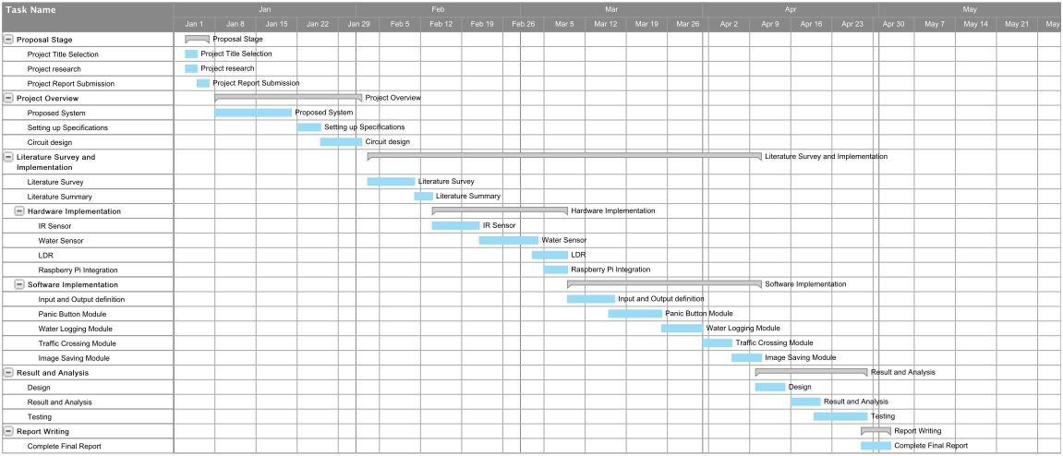
GANTT CHART

Slide 12
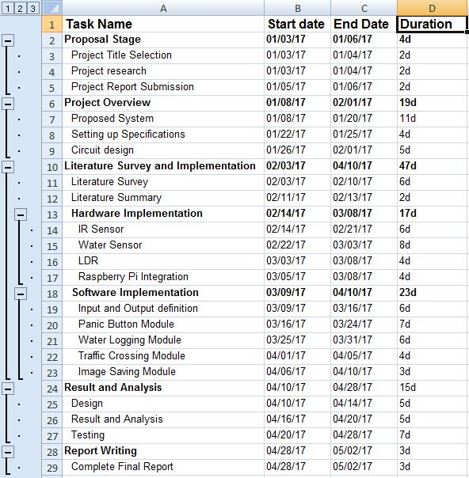
Work Breakdown Structure

Slide 13
Importance
This System helps in managing traffic. The way traffic is handled in our country is not an optimum way to handle traffic. This system helps to manage traffic congestion and alert the concerned authorities whenever there is a panic situation. This system will also be helpful whenever there is water logging on the roads. This will also reduce the traffic violations as whenever someone crosses the red light the IR sensor will get activated and the message will be sent to the concerned authority and image will also be uploaded. The system also aims in reducing the number of traffic officials at each corner and will help them in monitoring the real time traffic remotely.

Slide 14
Software Requirements
The Raspberry Pi primarily uses Linux kernel-based operating systems. The ARM11 is based on version 6 of the ARM which is no longer supported by several popular versions of Linux, including Ubuntu. The install manager for Raspberry Pi is NOOBS. The OSs included with NOOBS are:
• Arch Linux ARM
• Open ELEC
• Pi dora (Fedora Remix)
• Rasp bmc and the XBMC open source digital media center
• RISC OS – The operating system of the first ARM-based computer
• Raspbian (recommended) – Maintained independently of the Foundation; based on
ARM hard-float (armhf)- Debian 7 'Wheezy' architecture port, that was designed for a
newer ARMv7 processor whose binaries would not work on the Raspberry Pi, but
Raspbian is compiled for the ARMv6 instruction set of the Raspberry Pi making it
work but with slower performance. It provides some available software packages,
pre-compiled software bundles. A minimum size of 2 GB SD card is required, but a
4 GB SD card or above is recommended. There is a Pi Store for exchanging
Programs. The Raspbian Server Edition (RSEv2.4)', is a stripped version with other
Software packages bundled as compared to the usual desktop computer oriented
Raspbian.

Slide 15
Putty/MobaXterm Software
Putty is a free and open source terminal emulator, serial console and network file transfer application. It supports several network protocols, including SCP, SSH, Telnet, rlogin, and raw socket connection. It can also connect to a serial port. The name "PuTTY" has no definitive meaning. PUTTY was originally written for Microsoft Windows, but it has been ported to various other operating systems. Official ports are available for some Unix-like platforms, with work-in-progress ports to Classic Mac OS and Mac OS X, and unofficial ports have been contributed to platforms such as Symbian,Windows Mobile and Windows Phone.
MobaXterm is an enhanced terminal for Windows with an X11 server, a tabbed SSH client and several other network tools for remote computing (VNC, RDP, telnet, rlogin). MobaXterm brings all the essential Unix commands to Windows desktop, in a single portable exe file which works out of the box.
MobaXterm/Putty: How to start a SSH session from the command line
1) Type the path to .exe here.
2) Then type the connection type you wish to use (i.e. -ssh, -telnet, -rlogin, -raw)
3) Type the username…
4) Then type '@' followed by the server IP address.
5) Finally, type the port number to connect to, then press <Enter>

Slide 16
DETAILED DESIGN
Raspberry Pi
1) Processor / SoC (System on Chip)
The Raspberry Pi has a Broadcom BCM2835 System on Chip module. It has a ARM1176JZF-S processor
The Broadcom SoC used in the Raspberry Pi is equivalent to a chip used in an old smartphone (Android or iPhone). While operating at 700 MHz by default, the Raspberry Pi provides a real world performance roughly equivalent to the 0.041 GFLOPS. On the CPU level the performance is similar to a 300 MHz Pentium II of
1997-1999, but the GPU, however, provides 1 Gpixel/s, 1.5 Gtexel/s or 24 GFLOPS of general purpose compute and the graphics capabilities of the Raspberry Pi are roughly equivalent to the level of performance of the Xbox of 2001. The Raspberry Pi chip operating at 700 MHz by default, will not become hot enough to need a heatsink
or special cooling.

Slide 18
2) Power source
The Pi is a device which consumes 700mA or 3W or power. It is powered by a MicroUSB charger or the GPIO header. Any good smartphone charger will do the work of powering the Pi.
3) SD Card
The Raspberry Pi does not have any onboard storage available. The operating system is loaded on a SD card which is inserted on the SD card slot on the Raspberry Pi. The operating system can be loaded on the card using a card reader on any computer.
5) DSI Connector
The Display Serial Interface (DSI) is a specification by the Mobile Industry Processor
Interface (MIPI) Alliance aimed at reducing the cost of display controllers in a mobile device. It is commonly targeted at LCD and similar display technologies. It defines a serial bus and a communication protocol between the host (source of the image data)
and the device (destination of the image data).
A DSI compatible LCD screen can be connected through the DSI connector, although it may require additional drivers to drive the display.

Slide 19
5) GPIO
GPIO – General Purpose Input Output
General-purpose input/output (GPIO) is a generic pin on an integrated circuit whose behaviour, including whether it is an input or output pin, can be controlled by the user at run time.GPIO pins have no special purpose defined, and go unused by default. The idea is that sometimes the system designer building a full system that uses the chip might find it useful to have a handful of additional digital control lines, and having these available from the chip can save the hassle of having to arrange additional circuitry to provide them.
GPIO capabilities may include:
• GPIO pins can be configured to be input or output
• GPIO pins can be enabled/disabled
• Input values are readable (typically high=1, low=0)
• Output values are writable/readable
• Input values can often be used as IRQs (typically for wakeup events)
The production Raspberry Pi board has a 26-pin 2.54 mm (100 mil) expansion header,marked as P1, arranged in a 2x13 strip. They provide 8 GPIO pins plus access to ( I²C,SPI, UART), as well as +3.3 V, +5 V and GND supply lines. Pin one is the pin in the first column and on the bottom row.

Slide 20
GPIO Pin

Slide 21
6) RCA Video
RCA Video outputs (PAL and NTSC) are available on all models of Raspberry Pi.Any television or screen with a RCA jack can be connected with the RPi.
7) Audio Jack
A standard 3.5 mm TRS connector is available on the RPi for stereo audio output.
Any headphone or 3.5mm audio cable can be connected directly. Although this jack cannot be used for taking audio input, USB mics or USB sound cards can be used.
8) Status LEDs
There are 5 status LEDs on the RPi that show the status of various activities.

Slide 22
9) USB 2.0 Port
USB 2.0 ports are the means to connect accessories such as mouse or keyboard to the Raspberry Pi. There is 1 port on Model A, 2 on Model B and 4 on Model B+. The number of ports can be increased by using an external powered USB hub which is available as a standard Pi accessory.
10) Ethernet
Ethernet port is available on Model B and B+. It can be connected to a network or internet using a standard LAN cable on the Ethernet port. The Ethernet ports a controlled by Microchip LAN9512 LAN controller chip.
11) CSI connector
CSI – Camera Serial Interface is a serial interface designed by MIPI (Mobile Industry Processor Interface) alliance aimed at interfacing digital cameras with a mobile processor.
The RPi foundation provides a camera specially made for the Pi which can beconnected with the Pi using the CSI connector.

Slide 23
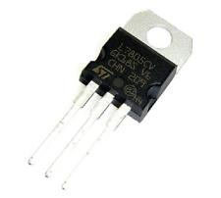
Voltage Regulator:
Voltage controllers are associated over the circuit to secure the supplies from any kind of voltage variances. All the gadgets we utilize are delicate and sensitive, so protection from any kind of variances is very important. A voltage controller is intended to naturally keep up a consistent voltage level. We are using the 7805 Voltage Regulator in this project. IC 7805 is a DC regulated IC of 5V. This IC is very flexible and is widely employed in all types of circuit like a voltage regulator. It is a three terminal device and mainly called input, output and ground.
Fig 4.8 Voltage Regulator

Slide 24
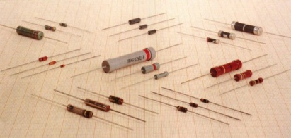
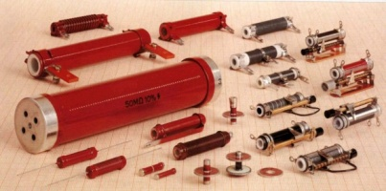
Resistors
Resistors are the most commonly used component in electronics and their purpose is to create specified values of current and voltage in a circuit. A number of different resistors are shown in the photos. (The resistors are on millimeter paper, with 1cm spacing to give some idea of the dimensions). Photo 1.1a shows some low-power resistors, whilephoto 1.1b shows some higher-power resistors. Resistors with power dissipation below 5 watt (most commonly used types) are cylindrical in shape, with a wire protruding from each end.
Fig 1.1a
Fig 1.1a

Slide 25
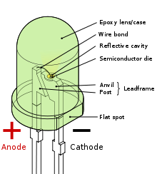
MODULE DESCRIPTION
LED
A light-emitting diode (LED) is a semiconductor light source. LEDs are used as indicator lamps in many devices and are increasingly used for general lighting. Appearing as practical electronic components in 1962, early LEDs emitted low-intensity red light, but modern versions are available across the visible, ultraviolet, and infrared wavelengths.
When a light-emitting diode is switched on, electrons are able to recombine with holes within the device, releasing energy in the form of photons. This effect is called electroluminescence, and the colour of the light (corresponding to the energy of the photon) is determined by the energy band gap of the semiconductor. An LED is often small in area (less than 1 mm²), and integrated optical components may be used to shape its radiation pattern. LEDs have many advantages over incandescent light sources including lower energy consumption, longer lifetime, improved physical robustness, smaller size, and faster switching. However, LEDs powerful enough for room lighting are relatively expensive, and require more precise current and heat management than compact fluorescent lamp sources of comparable output. Light-emitting diodes are used in applications as diverse as aviation lighting, automotive lighting, advertising, general lighting, and traffic signals. LEDs have allowed new text, video displays, and sensors to be developed, while their high switching rates are also useful in advanced communications technology. Infrared LEDs are also used in the remote control units of many commercial products including televisions, DVD players and other domestic appliances. LEDs are also used in seven segment display.

Slide 26
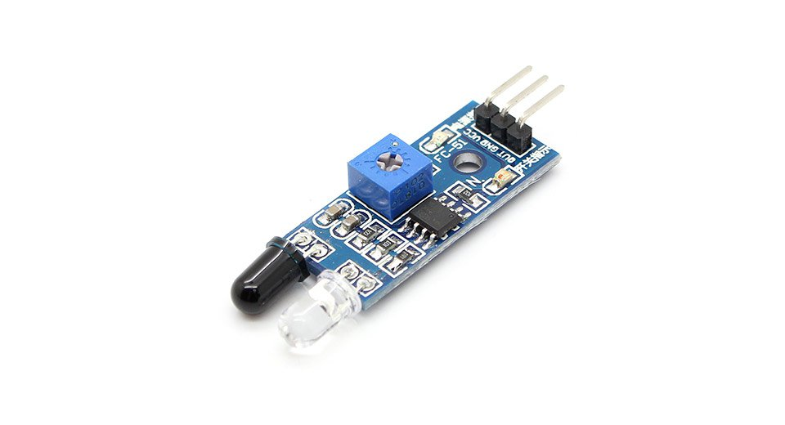
Infrared Sensor
Infrared (IR) is an invisible radiant energy, electromagnetic radiation with longer wavelengths than those of visible light, extending from the nominal red edge of the visible spectrum at 700 Nano meter (frequency 430 THz) to 1000000 nm (300 GHz)^{[1]} (although people can see infrared up to at least 1050 nm in experiments[). Most of the thermal radiation emitted by objects near room temperature is infrared.
Features: high reliability, high radiant density,PB free, Low forward voltage etc.

Slide 27
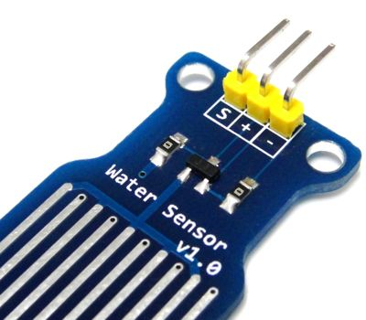
Water Sensor
A water sensor is an electronic device that is designed to detect the presence of water and
provide an alert in time to allow the prevention of water damage. A common design is a small
cable or device that lies flat on a floor and relies on the electrical conductivity of water to
decrease the resistance across two contacts. The device then sounds an audible alarm together with providing onward signalling in the presence of enough water to bridge the contacts. These are useful in a normally occupied area near any infrastructure that has the potential to leak water, such as HVAC, water pipes, drain pipes, vending machines, dehumidifiers, or water tanks.
Fig3.4 Water Sensor

Slide 28
Voltage Regulators
A voltage regulator is designed to automatically maintain a constant voltage level. A voltage regulator may be a simple "feed-forward" design or may include negative feedback control loops. It may use an electromechanical mechanism, or electronic components. Depending on the design, it may be used to regulate one or more AC or DC voltages.

Slide 29
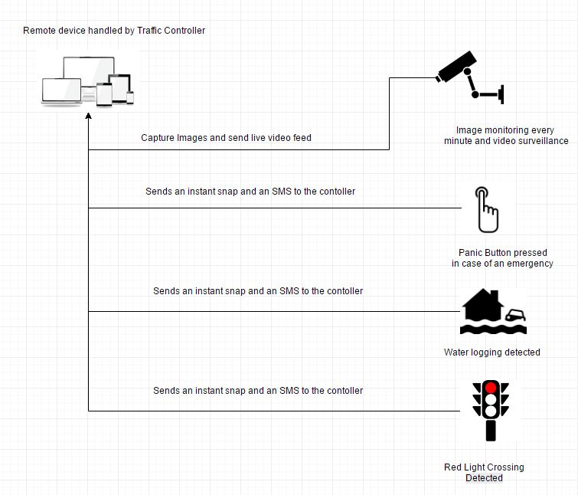
Architecture Development

Slide 30
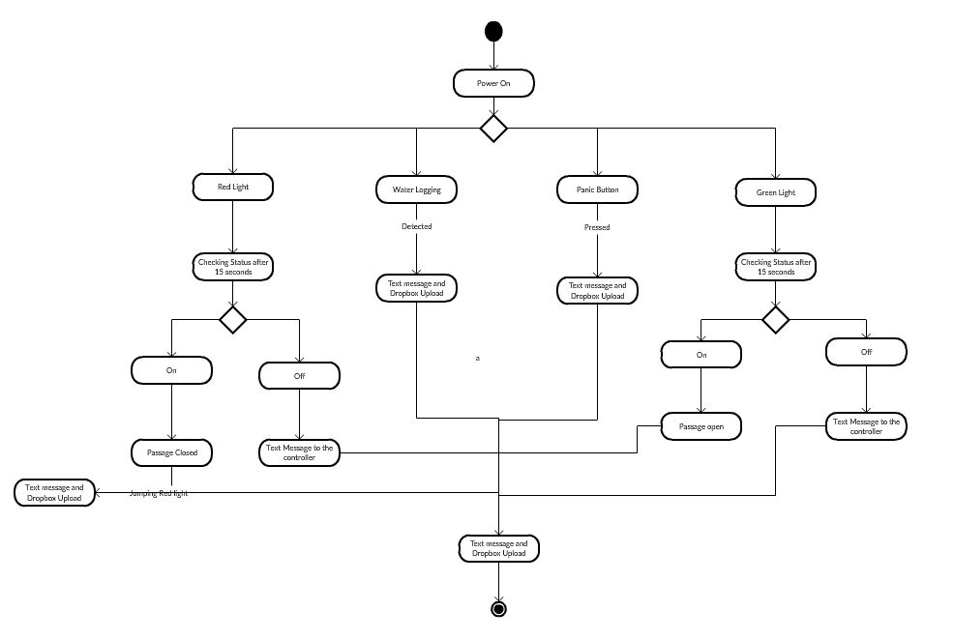
High Level Diagram
Activity Diagram

Slide 31
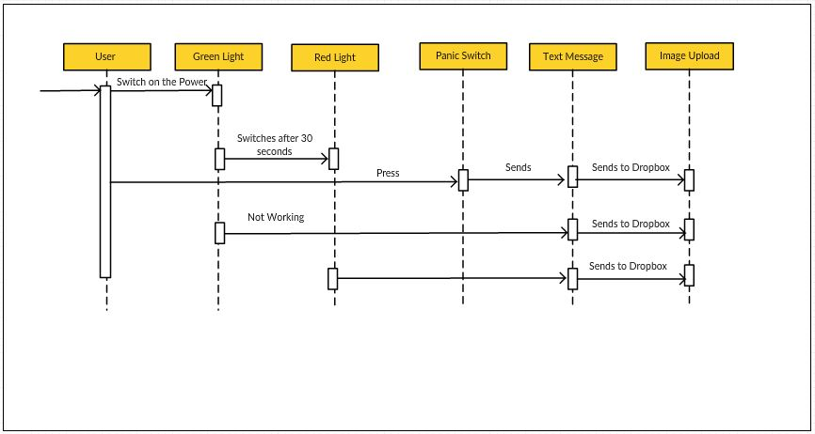
Sequence Diagram

Slide 32
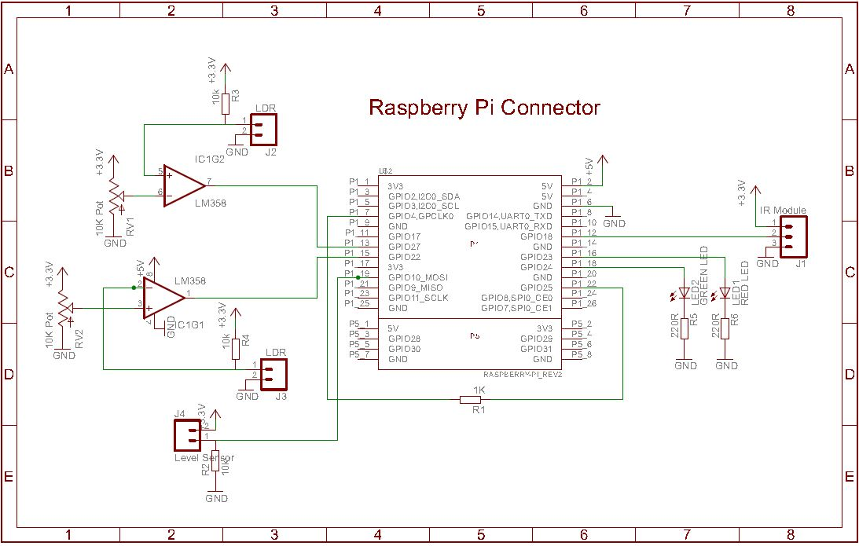
Low Level Design

Slide 33
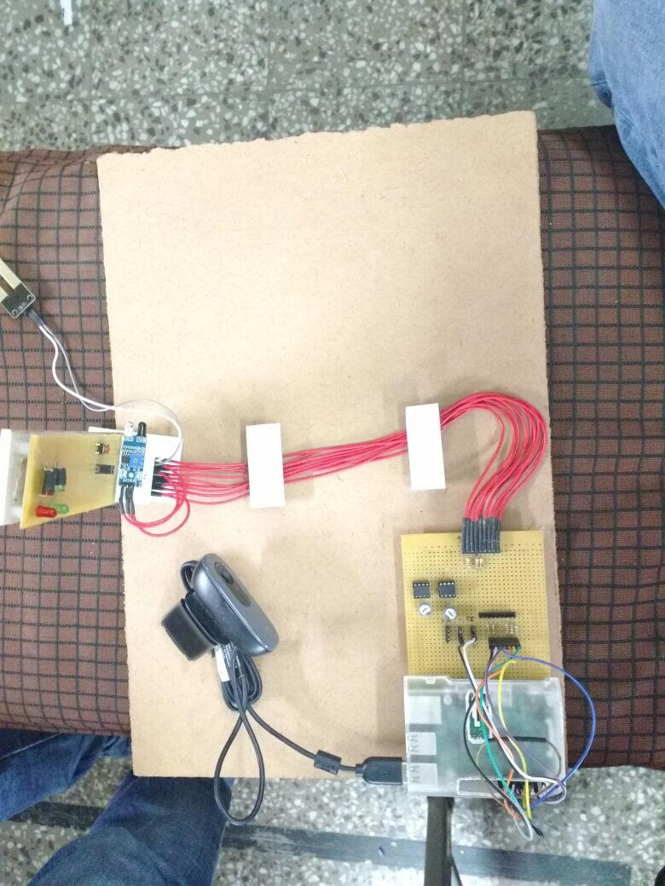
Hardware Implementation

Slide 34
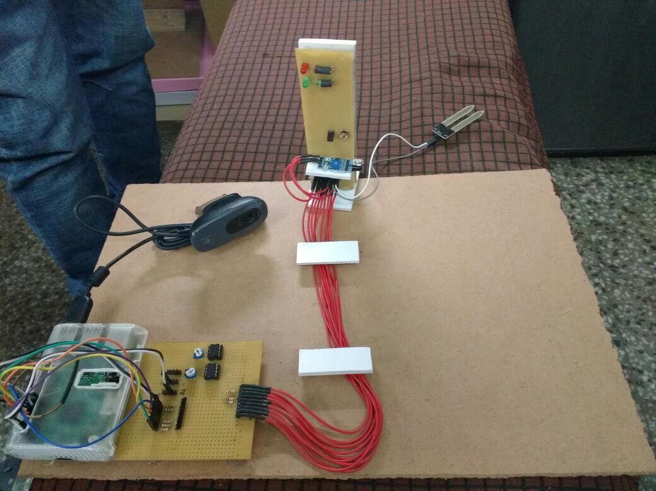

Slide 35
Main.py
import os
import time
import urllib
import urllib2
import subprocess
from subprocess import call
import RPi.GPIO as gpio
#=========================================================================
#message = input("Enter Message :")
message = 'System Started'
#number = input("Enter reciever phone number :")
number = '9873707004'
flag1=100
flag2=100
flag3=100
flag4=100
count=0
#=========================================================================
def sendSMS(uname, hashCode, numbers, sender, message):
data = urllib.urlencode({'username': uname, 'hash': hashCode, 'numbers': numbers, 'message' : message, 'sender': sender})
data = data.encode('utf-8')
request = urllib2.Request("http://api.textlocal.in/send/?")
f = urllib2.urlopen(request, data)#I need to use urllib2 and urllib because urlopen in urllib2 can take a request class but urllib does not include a function like urlencode.
fr = f.read()
return(fr)

Slide 36
def sw1_detect(pin):#switch for water logging
print 'Water Logging Detected'
gpio.remove_event_detect(19)#The water sensor is connected to the general purpose I/O pin 19
global flag1
if (flag1==100):
flag1=0
subprocess.call("./save1.sh", shell=False)
print('W button inactive')
resp = sendSMS('bishan@gmail.com', 'satnamWAHEGURU123', number, 'Water Logging Detected', 'TXTLCL')
print (resp)
def sw2_detect(pin):
print 'Panic Button Detected'
gpio.remove_event_detect(11)
global flag2
if (flag2==100):
flag2=0
subprocess.call("./save2.sh", shell=False)
print('P button inactive')
resp = sendSMS('bishan@gmail.com', 'satnamWAHEGURU123', number, 'TXTLCL', 'Panic Button Detected')
print (resp)
def sw3_detect(pin):
print 'Traffic Light Crossing Detected'
global count
if count>=6 and count<=12 :#red light 6 to 12 seconds
gpio.remove_event_detect(12)
global flag3
if (flag3==100):
flag3=0
subprocess.call("./save3.sh", shell=False)
print('T button inactive')
resp = sendSMS('bishan@gmail.com', 'satnamWAHEGURU123', number, 'TXTLCL', 'Light Crossing Detected')
print (resp)
def sw4_detect(pin):
print 'Image Saving Detected'
gpio.remove_event_detect(7)
global flag4
if (flag4==100):
flag4=0
subprocess.call("./save4.sh", shell=False)
print('I inactive')

Slide 37
def red_on():
print 'Red On'
def green_on():
print 'Green On‘
def init_io():
gpio.setmode(gpio.BOARD) # Set pin numbering to board numbering
gpio.setwarnings(False)
gpio.setup(7, gpio.IN) # Set up pin 7 as an input for 1 minute
gpio.add_event_detect(7, gpio.RISING, callback=sw4_detect, bouncetime=200)
gpio.setup(11, gpio.IN) # Set up pin 11 as an input for panic
gpio.add_event_detect(11, gpio.RISING, callback=sw2_detect, bouncetime=200)
gpio.setup(12, gpio.IN) # Set up pin 12 as an input for traffic
gpio.add_event_detect(12, gpio.FALLING, callback=sw3_detect, bouncetime=200)
gpio.setup(19, gpio.IN) # Set up pin 7 as an input
gpio.add_event_detect(19, gpio.RISING, callback=sw1_detect, bouncetime=200)
gpio.setup(22, gpio.OUT) # Set up pin 22 as an output pin for 1 minute capture
gpio.output(22, False)
gpio.setup(16, gpio.OUT) # Set up pin 16 as an output red color
gpio.output(16, False)
gpio.setup(18, gpio.OUT) # Set up pin 18 as an output green color
gpio.output(18, True)
if (gpio.input(13) == True): # Physically read the pin now
print('13 High')
else:
print('13 Low')
if (gpio.input(15) == True): # Physically read the pin now
print('15 High')
else:
print('15 Low')

Slide 38
Save1.sh
#!/bin/bash
DATE=W$(date +"%Y-%m-%d_%H%M%S")
sudo fswebcam -r 640x480 /home/pi/script/images/$DATE.jpg
/home/pi/Dropbox-Uploader/dropbox_uploader.sh upload /home/pi/script/images/$DATE.jpg $DATE.jpg

Slide 39
Save2.sh
#!/bin/bash
DATE=P$(date +"%Y-%m-%d_%H%M%S")
sudo fswebcam -r 640x480 /home/pi/script/images/$DATE.jpg
/home/pi/Dropbox-Uploader/dropbox_uploader.sh upload /home/pi/script/images/$DATE.jpg $DATE.jpg

Slide 40
Save3.sh
#!/bin/bash
DATE=I$(date +"%Y-%m-%d_%H%M%S")
sudo fswebcam -r 640x480 /home/pi/script/images/$DATE.jpg
/home/pi/Dropbox-Uploader/dropbox_uploader.sh upload /home/pi/script/images/$DATE.jpg $DATE.jpg

Slide 41
Save4.sh
#!/bin/bash
DATE=M$(date +"%Y-%m-%d_%H%M%S")
sudo fswebcam -r 640x480 /home/pi/script/images/$DATE.jpg
/home/pi/Dropbox-Uploader/dropbox_uploader.sh upload /home/pi/script/images/$DATE.jpg $DATE.jpg

Slide 42
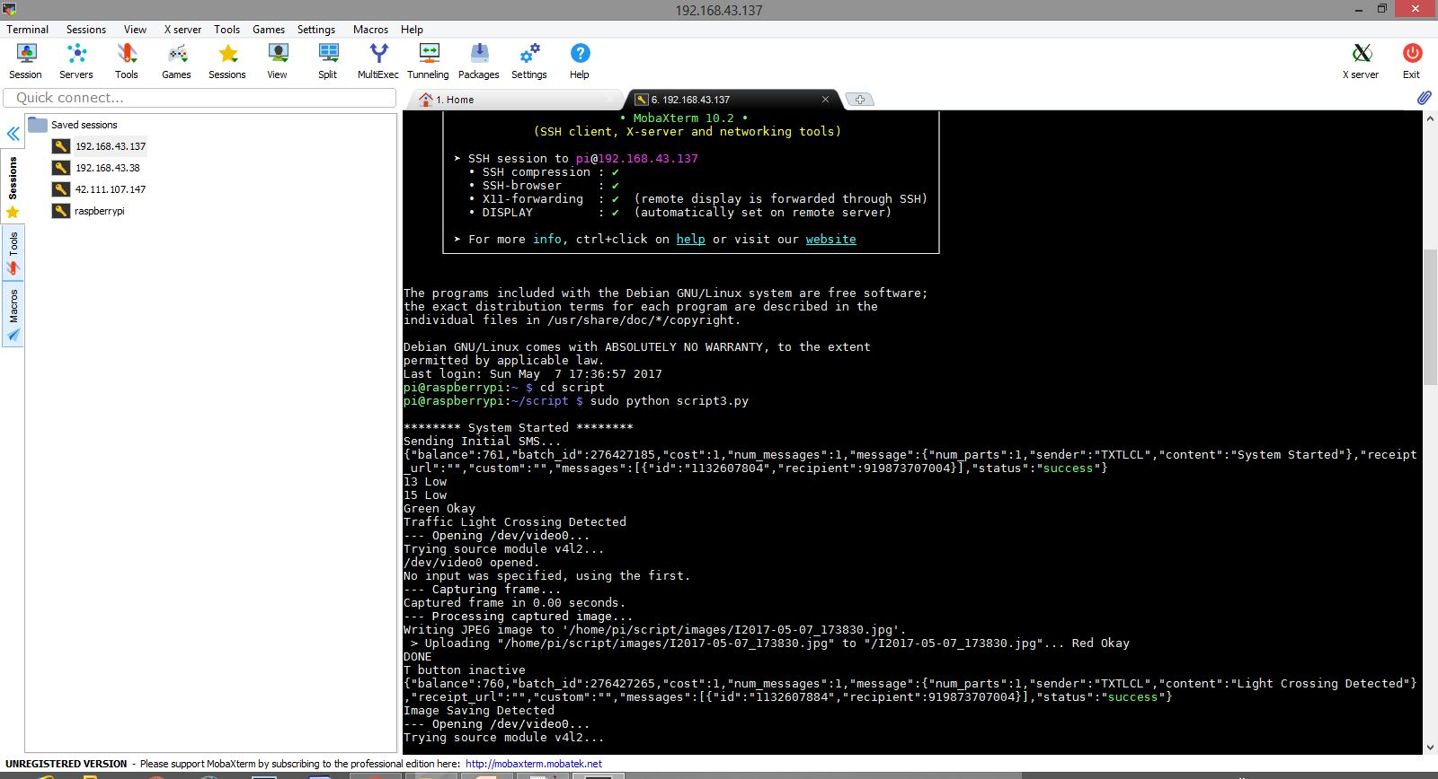

Slide 43
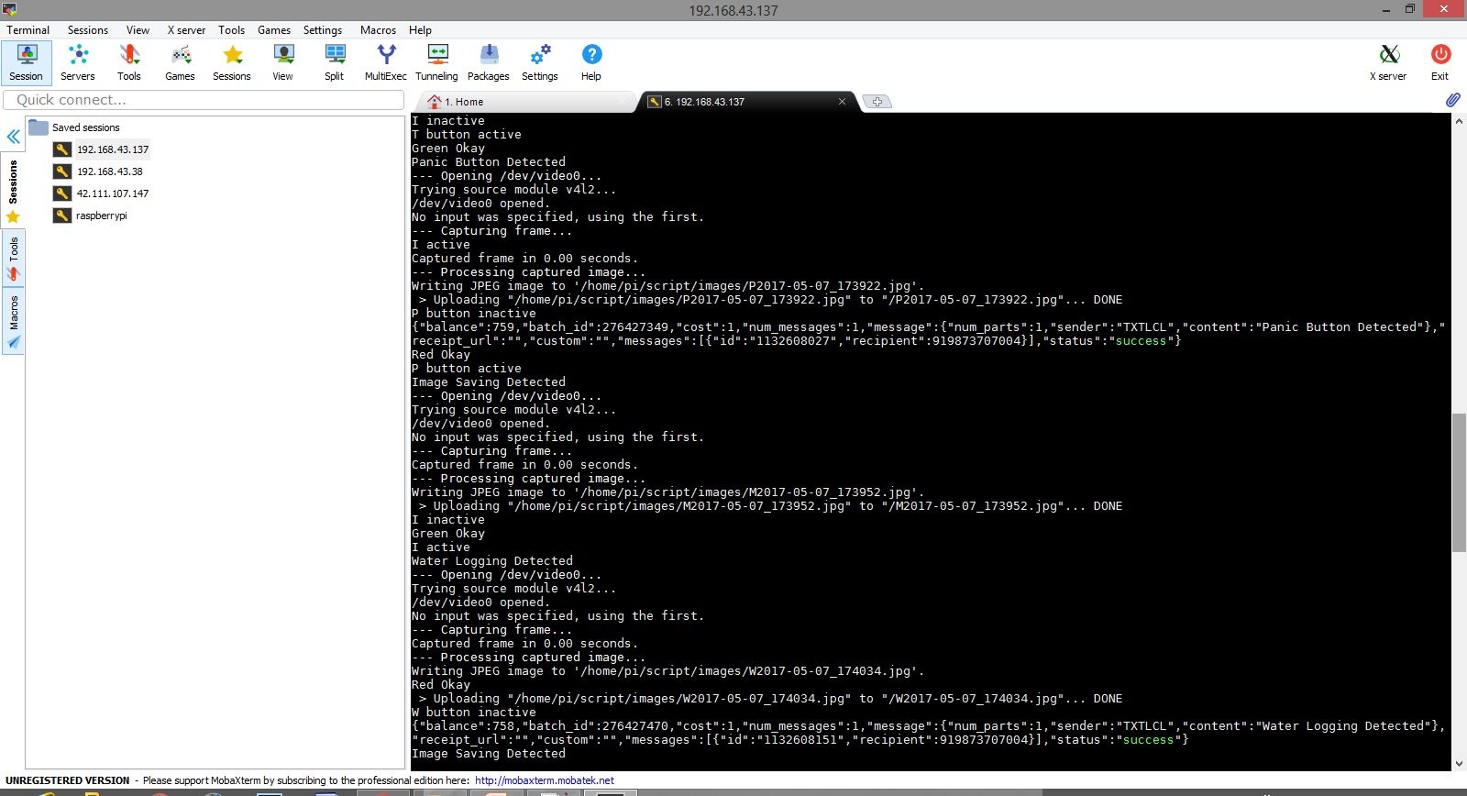

Slide 44
Unit Testing
After the completion of hardware and software coupling several tests were done on design. This section explains our procedures for testing the final products. Using the following tests we were able to verify that our product was sound. Some observations and corrections were made as follows:
The system would not work when the raspberry pi device was switched on after switching on the rest of the equipment. This was due to the fact that the signals sent at first by the system to the phone do not die of the line immediately and affect subsequent signals sent even after connecting and resetting the system. This can be prevented by connecting the raspberry pi adopter to power supply first before powering the system.
It was observed that actions could not be performed by the IR sensor on the device (or LED in the equipment) when the LED was GREEN. This was due to on green light which made it not to process new data sent by phone during an existing cycle, because on the green light IR sensor need not to capture any traffic rule breaker image because its already green however web cam will keep taking picture every minute as it functioned that way. The solution was flushing the buffer after each command so that the next command could be executed well. When the RED LED is lit, then all the four corresponding sensors work perfectly fine.
The raspberry pi device will not work if it is not connected to wifi which is used to obtain the ip address of the raspberry pi device.

Slide 45
Integration Testing
Software integration testing is the incremental integration testing of two or more integrated software components on a single platform to produce failures caused by interface defects. The task of the integration test is to check that components or software applications, e.g. components in a software system or – one steps up – software applications at the company level – interact without error.
In this project, integration testing involves the testing of all the sub modules and modules together.
We have 5 basic modules(IR sensor module, Water Sensor module, Image saving module, LDR module, Live video surveillance) of testing which we test together with each other over 2 phases(Red light phase and green light phase). During the phase where green light is on the IR sensor module is inactive and does not upload any images or sends any text messages rest all the modules work. During the Red light phase all the modules are working and if there is any detection the traffic controller is notified.

Slide 46
Test Cases Generation
Test cases:
In case of Green Light.
a. Working of green light is checked by removing of switch which sees that whether green is active or not before it has to be turned green if not then sends a message.
b. Checking of water level is determined at a certain level.
c. Capturing of photos after every minute and storing it in dropbox.
d. Working of panic button in any condition and capturing its photo at the moment.
2. In case of Red Light
a. Working of red light is checked by removing of switch which sees that whether red is active or not, if not then sends a message.
b. Checking the working of water logging and panic button and sending text message at the same time.
3. Working of video surveillance at every moment.

Slide 47
Test Results
The green light and red light are working fine.
Both the webcams are working properly.
RaspberryPi is working without any errors.
LDR is detecting if there is any problem in the traffic lights.
IR sensor is detecting the traffic light crossing perfectly.
Water sensor detects any water logging immediately.
The first webcam is capturing photos during traffic light crossing and water logging.
The second webcam is capturing video at all times.
The webcam is also capturing images after every minute.

Slide 48
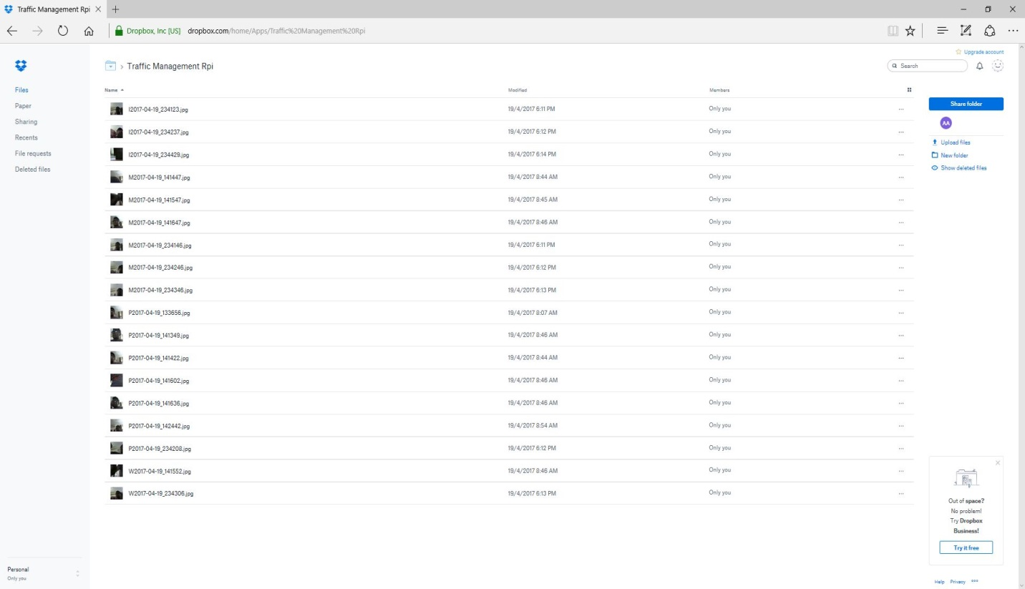
Output/Results
Once we fire up the raspberry pi kernel it connects to lamp web camera instantly to give the live video feed of the street. And after execution of the program we start receiving text messages on the number we specified.
Also the traffic controller (end user) can access the photos clicked at several intervals through their drop box account.

Slide 49
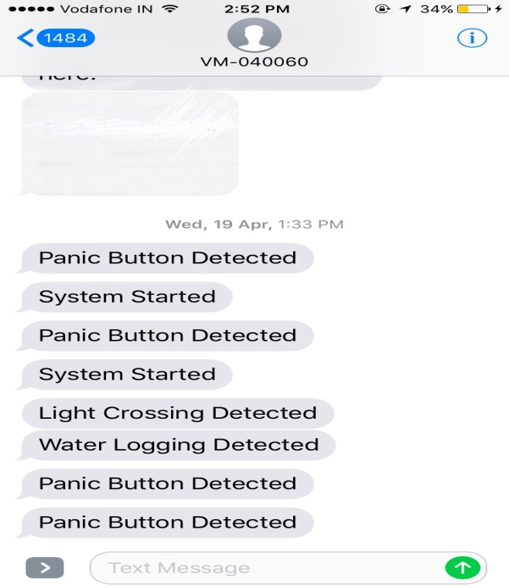
Screenshots of the DropBox account and Text Messages received by the controller
The images are categorized under 4 categories (M-photos clicked after each minute, W-photos clicked if water logging is detected, P-photos clicked if panic button is pressed, I-photos clicked if IR sensor detects a road crossing.) Whenever any of the 4 scenarios occur the controller is also notified via Text messages.
The photos are stored locally to the SD card on the raspberry pi

Slide 50
Results Analysis/Discussion
According to the results obtained by testing different modules with many test cases, the working of model and output gained are optimized to maximum accuracy. The working of panic button sounds the alarm instantly. Detection of water level is working properly. Photos are stored according to the correct detection of module like which interrupt has occurred.

Slide 51
Conclusion
The proposed system is user friendly, low cost and easy to understand. The range of raspberry pi is global so the user can use the system from any corner of the world. It will automate the home appliances. For future work we can add many features in the system such as sensors for gas and temperature. After testing the system, we will implement it on the hardware. The project is aimed to design and implement a Raspberry pi bas traffic control system.
After doing different tests and programming different codes, eventually the obliged outcome is put forward. It is a fast and efficient approach to control the devices. This equipment works anywhere with a great gathering sign. With regards to the requirements gathered the manual work and the complexity in counting can be achieved with the help of electronic devices.
The project “SMART TRAFFIC MANAGEMENT SYSTEM USING RASPBERRY PI” has been successfully designed and tested. Integrating features of all the hardware components used have developed it. Presence of every module has been reasoned out and placed carefully thus contributing to the best working of the unit. Secondly, using highly advanced IC’s and with the help of growing technology the project has been successfully implemented.

Slide 52
Scope of Future Work
Continuous growth of population all over the world creates a great challenge to the transport management systems. The conventional methods are no longer effective enough for solving complex and challenging transportation management problems. More economical, more efficient and thus more intelligent methods have to be developed to deal with these challenging problems. Knowledge from different research areas is needed for developing these systems. Very often complex transportation systems require integration of different methods from different branches of science. Due to the increased amount of vehicles, it is necessary to take effective steps in order to control the traffic and hence avoid all types of loses that is caused due to traffic. Once we have predicted a high traffic density for a network segment, we can initiate strategies to avoid this problem. In case of a road network, navigation systems can try to bypass the critical zone. Furthermore, any traffic control systems can inform the drivers about the traffic jam risk in order to guide them around the critical zone. In order to detect the traffic different sensors are being used and different techniques are used to determine the traffic and thus solve the problem related to traffic. Computer vision presents significant advantage over other traditional vehicle measurement technologies. Computer vision systems are more flexible, less invasive, and more precise, more robust, easier to maintain, produce richer information, do not affect the integrity of the road and offer as an a added bonus, the possibility to transmit images for human supervision.
Use of Artificial Intelligence can be increased with the sensors and predicts the problems which can arise. A project on traffic management solution detecting real-time traffic density estimation and prediction can be made.

Slide 53
References
Weblinks:
About Raspberry Pi, http://www.raspberrypi.org/about/
Raspberry Pi Hardware information, http://elinux.org/RPi_Hardware
How SoC works, http://www.androidauthority.com/how-it-works-systems-on-a-chip-soc-93587/
Journal:
Monahan, Torin. 2007. “War Rooms” of the Street: Surveillance Practices in Transportation Control Centres. The Communication Review 10 (4):367-389.
Smart Traffic Management System-International Journal of Computer Applications (0975 – 8887) Volume 75– No.7, August 2013
S.A. Mulay, C.S. Dhekne, R.M. Bapat, T.U. Budukh, S.D. Gadgil Department of Computer, PVG’s COET, Intelligent traffic management and public transportation system.

